Slide 1
Gold price analysis
By Muhammad Talha ali

Slide 2
Mentorness ml internship
1. Time Series Analysis
2. Advanced Modeling
3. Trading Strategy Development
4. Market Sentiment Analysis
5. Statistical Analysis

Slide 3
Introduction to
Gold Price Analysis

Slide 4

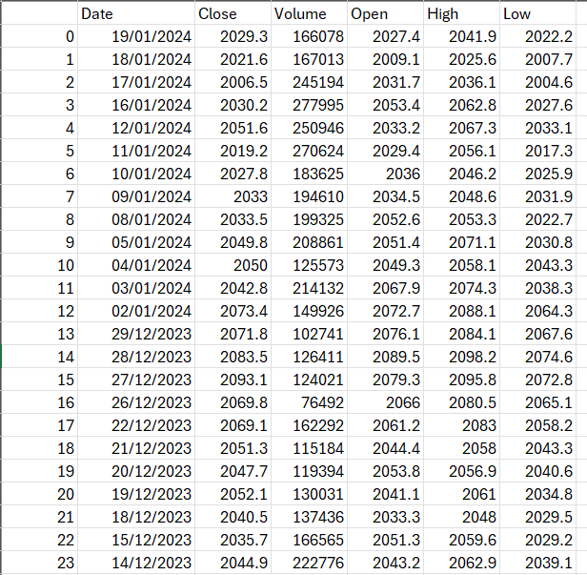
Features of Dataset
Date
Close
Volume
Open
High
Low

Slide 5
Dataset Description
1. Date: A unique identifier for each trading day.
2. Close: Closing price of gold on the respective date.
3. Volume: Gold trading volume on the corresponding date.
4. Open: Opening price of gold on the respective date.
5. High: The highest recorded price of gold during the trading day.
6. Low: The lowest price recorded for gold in the trading day.

Slide 6
1. Time Series Analysis
- Explore historical trends and patterns in gold prices over the specified time period.
- Identify seasonality, cyclicality, and any discernible long-term trends in the gold market.

Slide 7
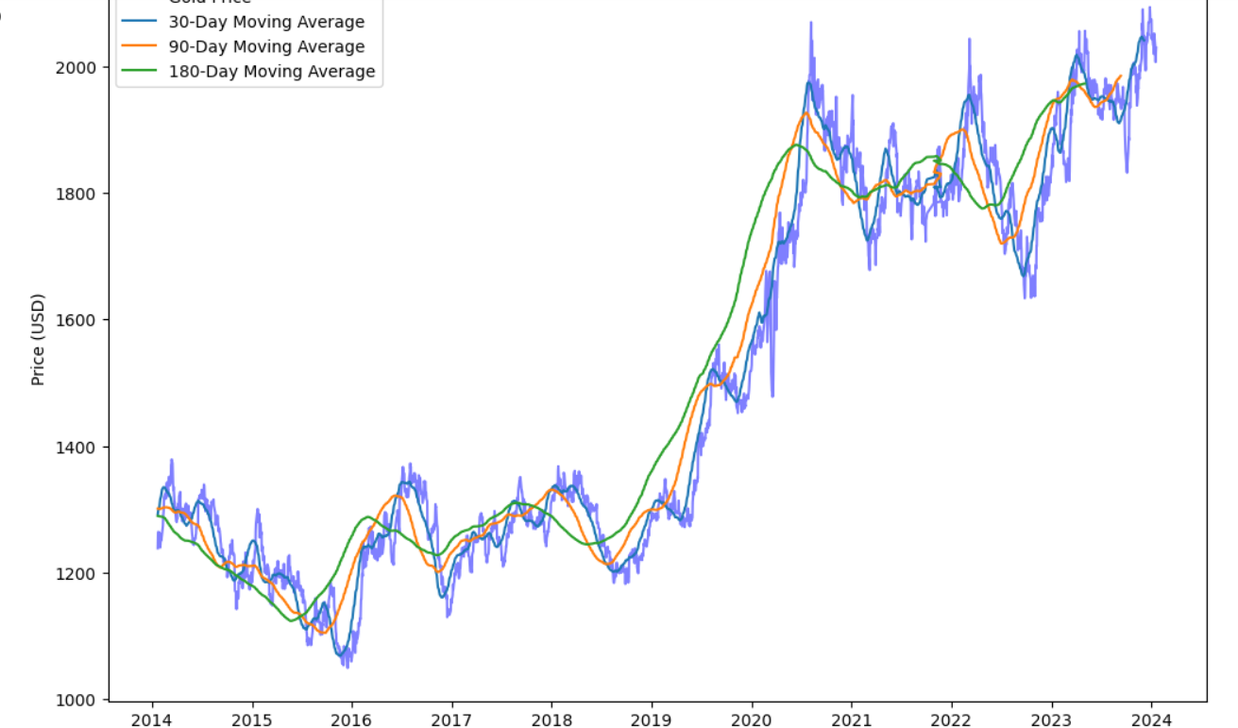
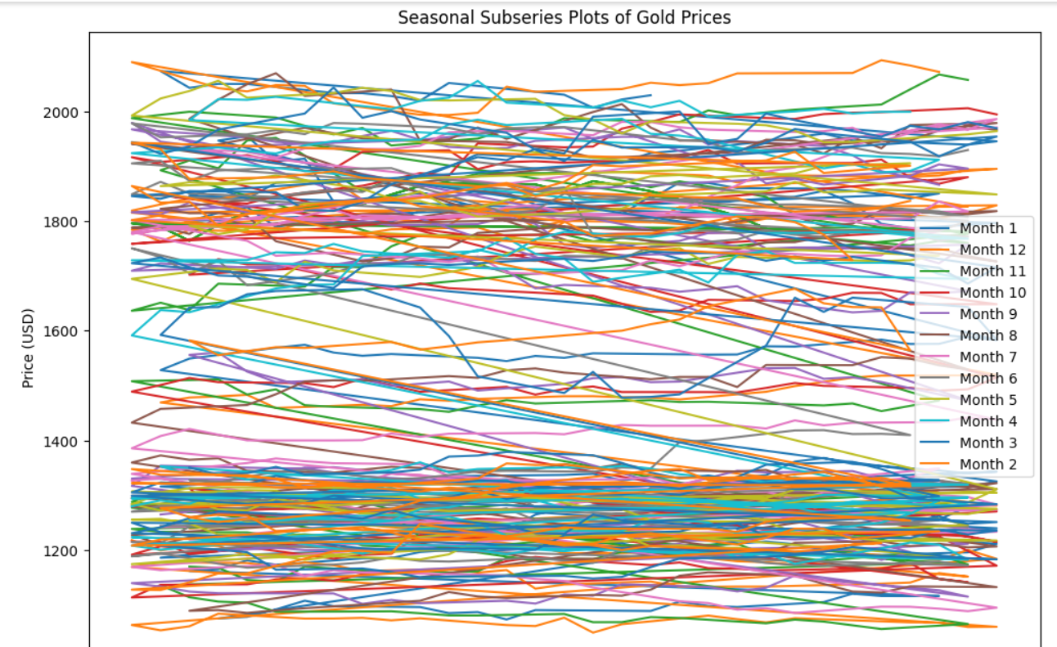
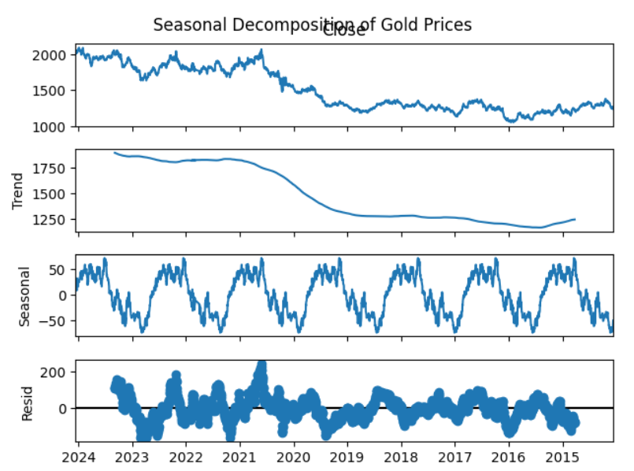
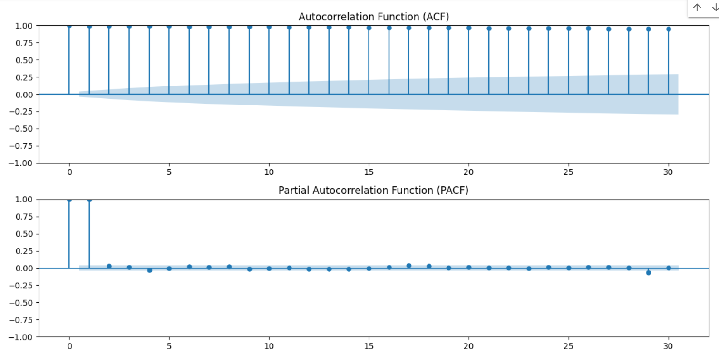
1. Time Series Analysis

Slide 8
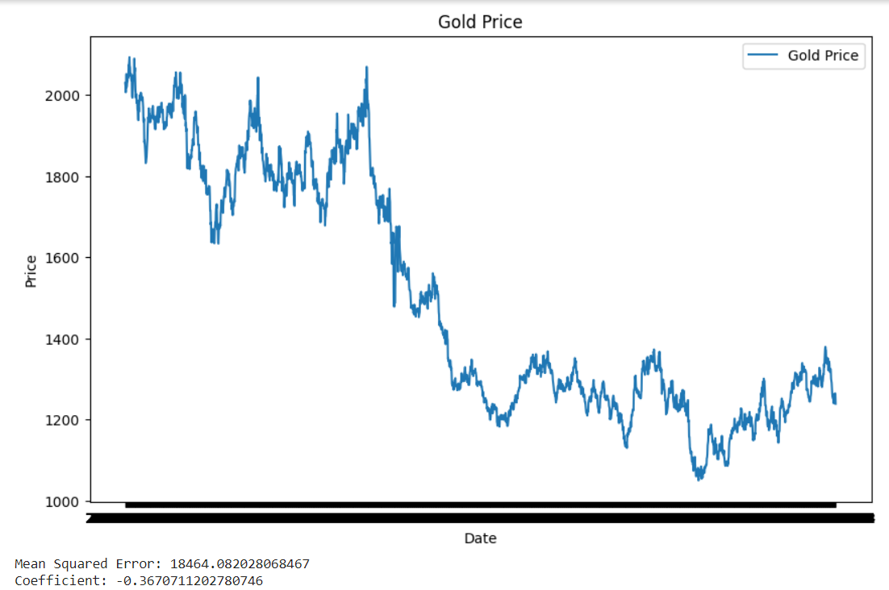
2- Advanced Modeling
- Develop predictive models to forecast future gold prices based on historical data.
- Evaluate and compare the performance of different forecasting algorithms

Slide 9
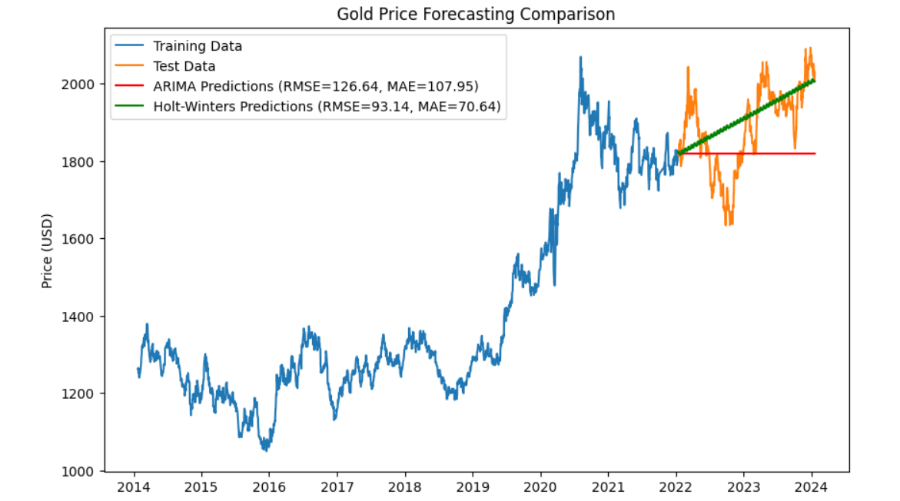
2- Advanced Modeling

Slide 10
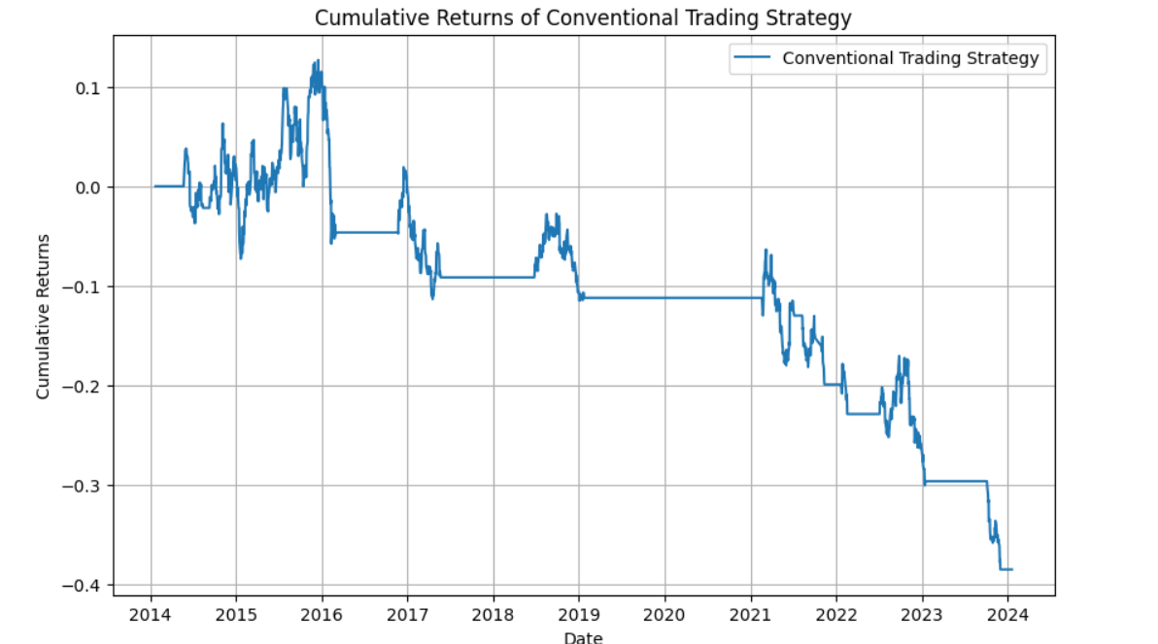
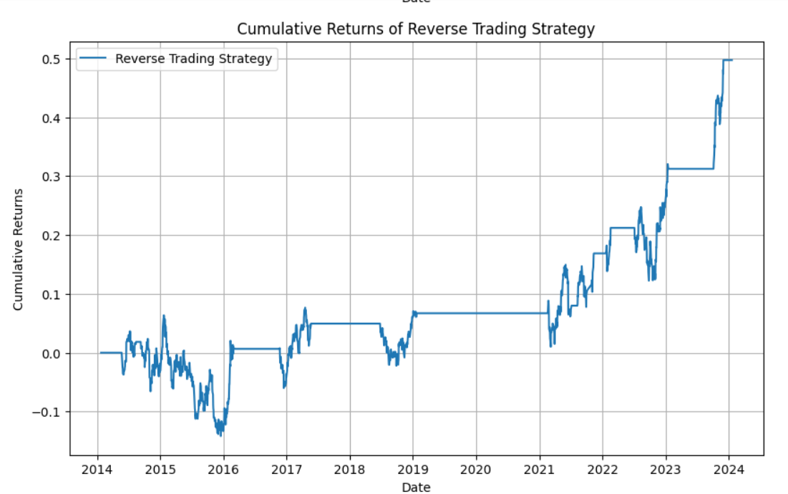
3. Trading Strategy Development
Formulate and backtest trading strategies based on the provided price and volume information. - Explore the feasibility of reverse trading strategies for profit maximization.

Slide 11
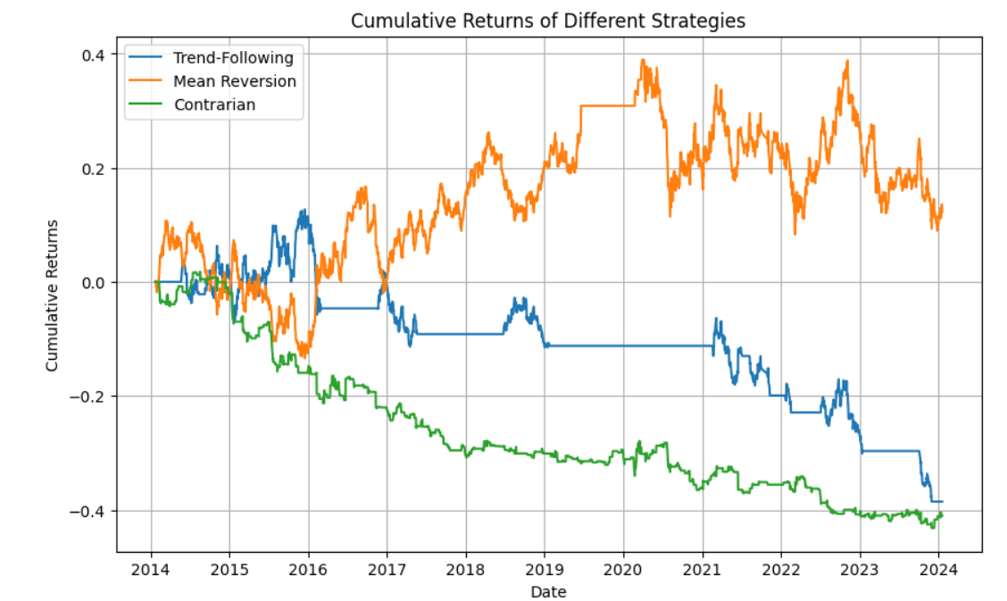
3. Trading Strategy Development

Slide 12
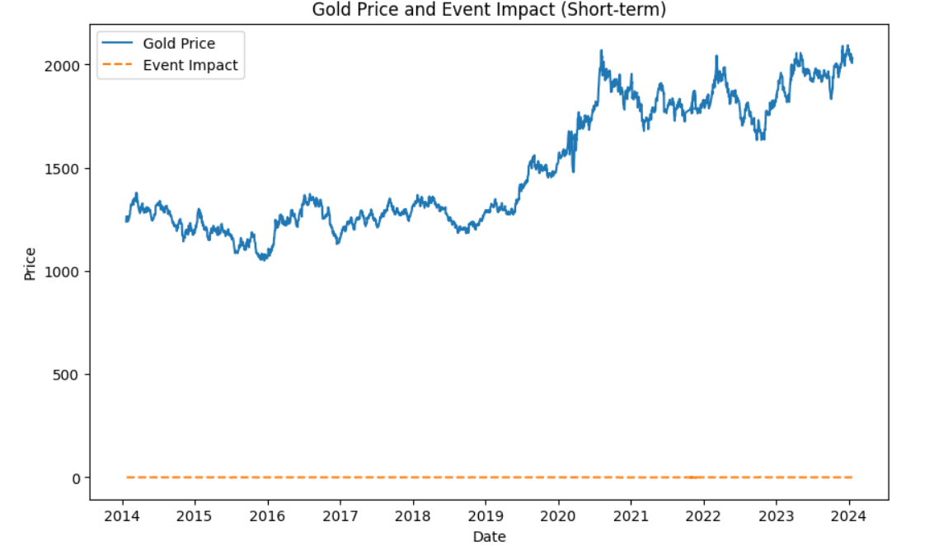
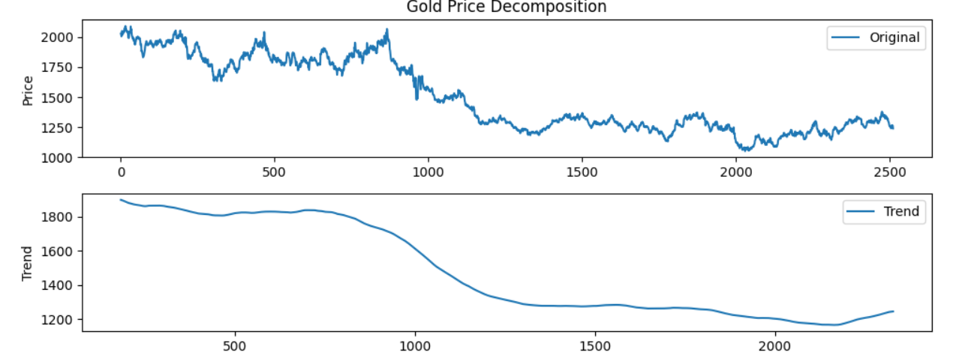
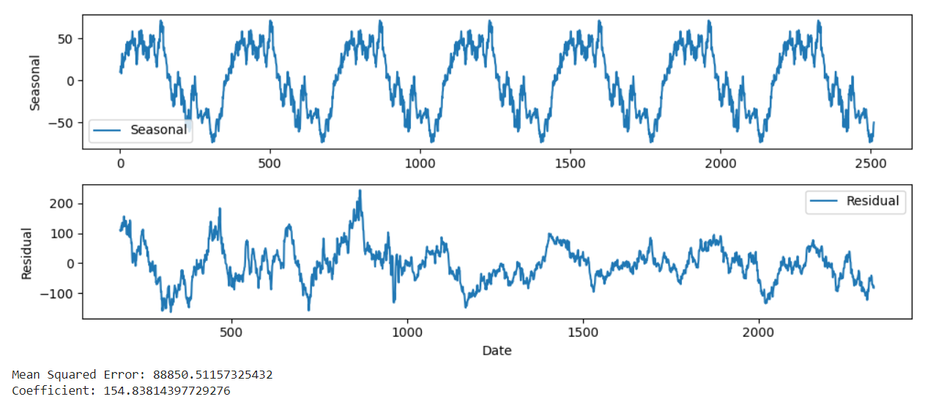
4. Market Sentiment Analysis
Investigate the impact of market events on gold prices.
Assess marketsentiment and its influence on short-term and long-term price movements.

Slide 13
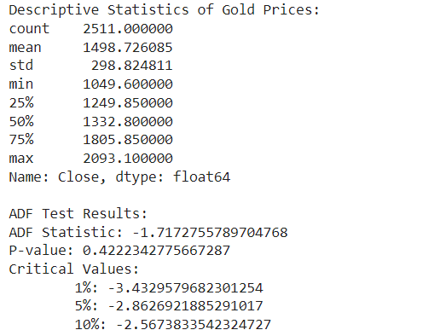
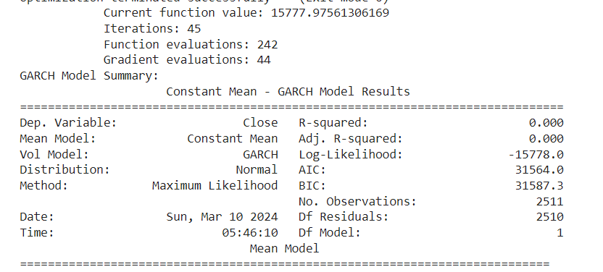
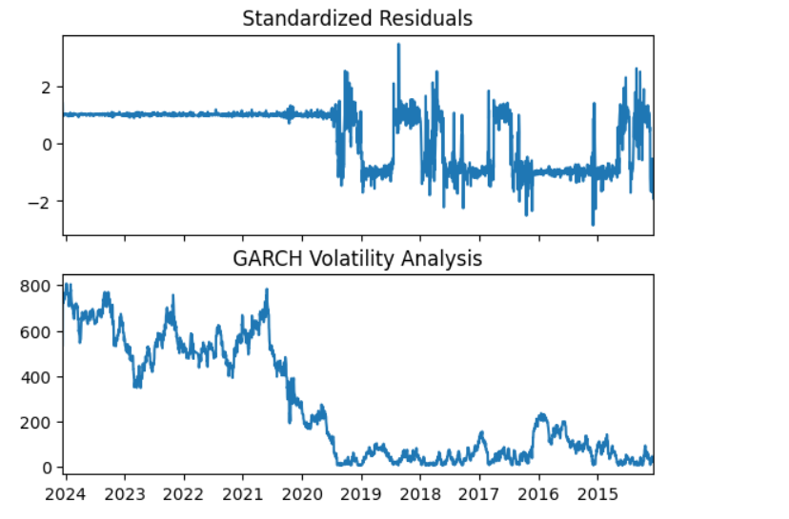
5. Statistical Analysis
- Conductstatistical tests and analyses to gain insights into the characteristics of gold price movements.
- Explore correlations with external factors and macroeconomic indicators

Slide 14
The End
Feel free for any query or question

